Slide 1
Mantid Release Presentation
Release 3.2
ISIS

Slide 2
Muon

Slide 3
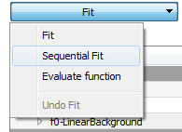
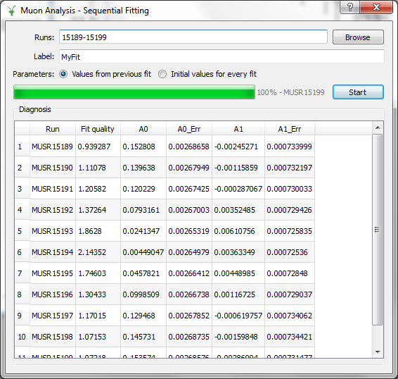
MuonAnalysis

Slide 4
MuonAnalysis
http://www.mantidproject.org/Release_Notes_3_2_MuonAnalysis
Interface can now read CHRONUS, MUT and 'old' EMU data
Make the interface less sensitive to filenames, e.g. can now use 00015189.nxs instead of MUSR00015189.nxs
Added new option to Rebin algorihtm, FullBinsOnly so that can ignore last bin that may have width smaller than that requested bin width
'Force' the user to use numeric characters for text boxes where alphabetic characters does not make sense
The results table created from the 'Results Table' tab made editable
Remove unpredictable bug that sometimes happened when datasets read in quick succession, by refactoring how groupping is handled within interface
Fix bug to allow loading of data from the same instrument but where the number of histograms varies
Add new plot policy option: "Use previous window" in Settings tab, which if selected will plot new data in previous plot window
Allow data with zero good frames to be loaded and display warning to user
Updated 'run information' to output Frames, and Counts to 3 decimal

Slide 5
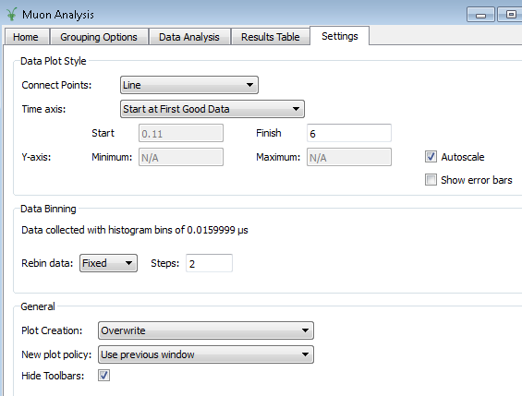
MuonAnalysis – Settings tab
Now can’t type
letters
Run with FullBinsOnly=True

Slide 6
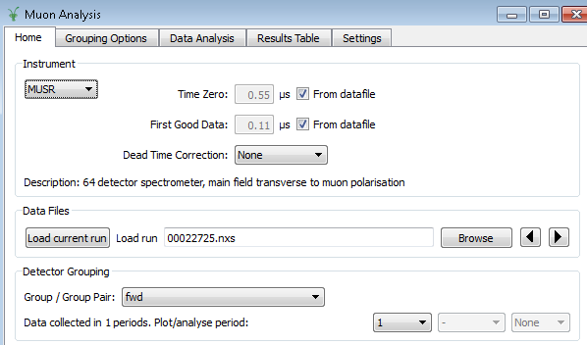
MuonAnalysis – Home tab

Slide 7
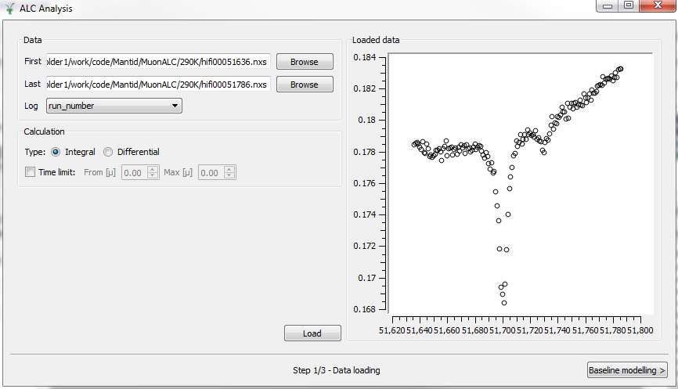
New ACL Interface (ACL = Avoided Level Crossing)

Slide 8
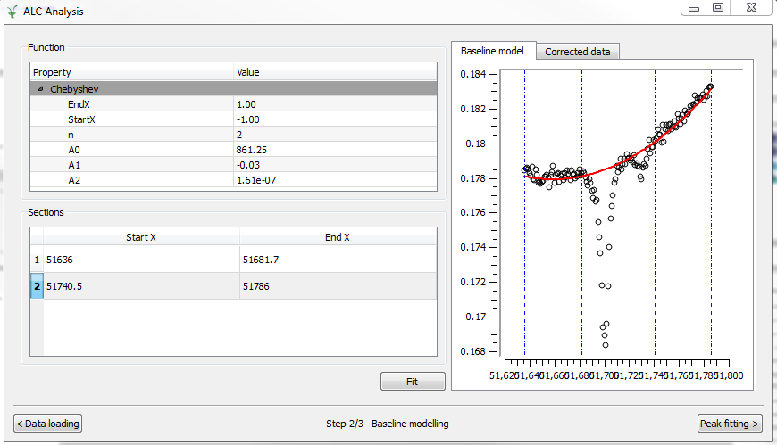
New ACL Interface (ACL = Avoided Level Crossing)

Slide 9
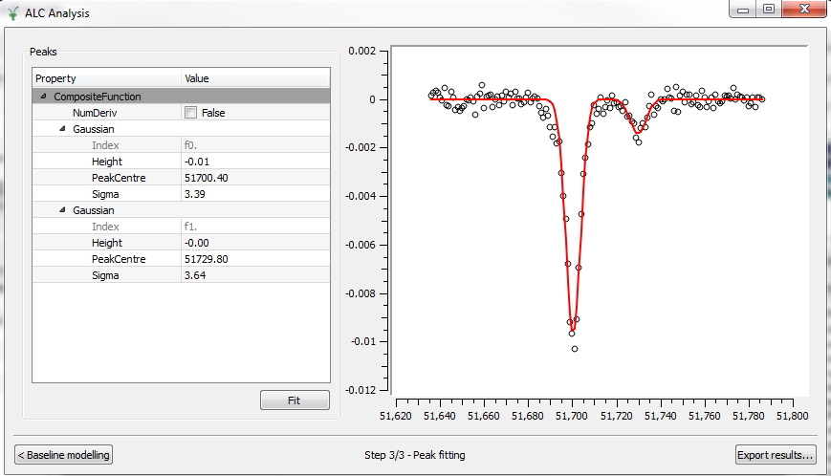
New ACL Interface (ACL = Avoided Level Crossing)

Slide 10
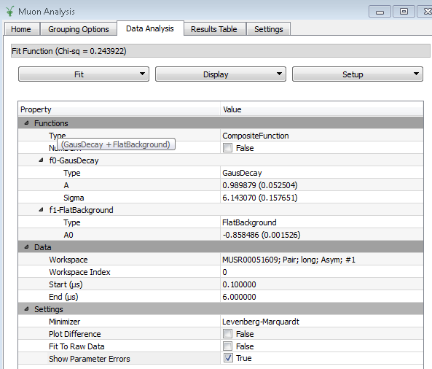
Muon Other
Show high level summary formula string in fit function toolbox
Show error in fitting tab
Wrap Fortran MaxEnt routine in F2Py and expose to Mantid

